Slide 1
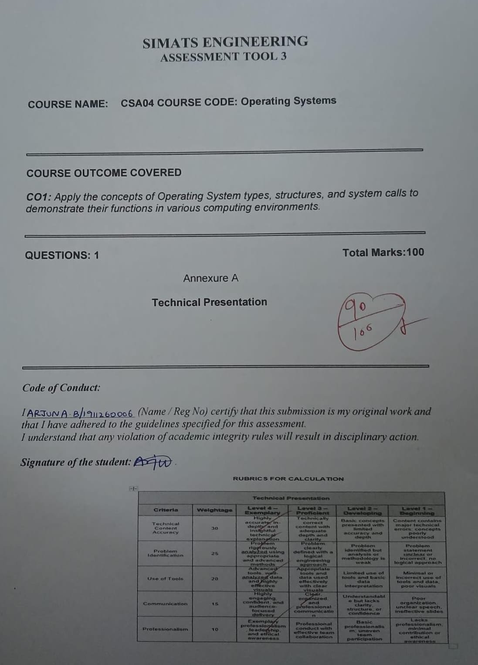

Slide 2





How an Operating System Runs a Bank
What happens behind the screen when thousands of people use the bank at once
NAME: ARJUN A B
REG NO: 1911260006
COURSE NAME: OPERATING SYSTEMS
COURSE CODE: CSA0412
Notes:
Say hello and tell them what you will explain: how the operating system keeps a bank running when thousands of people use it at the same time.

Slide 3

Think of a Busy Bank
Imagine it is salary day. Thousands of people are using ATMs, UPI and net banking at the same moment
Nobody wants to wait, and nobody can afford a wrong balance
Someone has to manage all this behind the scenes. That someone is the operating system
Mobile
ATM
Net banking
The bank server and its OS
Notes:
Keep it relaxed: describe salary day at a bank. The OS decides who gets the CPU, memory and disk, and when.

Slide 4





What the Bank Needs from Its OS
Speed
Many users
Security
Customers should not wait around
Everyone is served at the same time
Only the real account holder gets in
Reliability
Accuracy
Keeps working even if something fails
No rupee should ever go missing
Notes:
These five needs are the reason we pick a certain type of OS and a certain structure, which come next.

Slide 5




Which Type of OS Fits a Bank?
Multi-user
Multi-CPU
Many people log in together
Multiprocessing: several CPUs share the load
My choice
A multi-user, multiprocessing, distributed OS, like Linux, UNIX or IBM z/OS. Real-time ideas help for quick replies too.
Real-time
Distributed
Must answer within a fixed time
Many servers work like one
Notes:
Real-time features help with quick replies, but the main things a bank needs are multi-user, multiprocessing and distributed support.

Slide 6


How the OS Is Built
Banking apps: ATM, UPI, net banking
A layered kernel
Each layer only talks to its neighbour
Easy to fix one part without breaking the rest
If one piece fails, the whole bank does not stop
System calls: the doorway
Kernel: the real manager
Hardware: CPU, memory, disk
Notes:
A layered structure is the easiest to explain. Real systems like Linux are modular kernels built on the same idea.

Slide 7

What is a System Call?
A system call is how a program politely asks the OS for help, for example to read a file or use the disk.
Like a restaurant: you (the app) tell the waiter (system call), and the waiter goes to the kitchen (kernel).
Banking app
System call
Kernel
Hardware
Notes:
A normal program is not allowed to touch the hardware directly, so it has to go through a system call.

Slide 8





Sending Money: Step by Step
1. Request comes in
2. Check balance
3. Lock account
A new process starts for you
Open and read your record
So two payments do not clash
fork() / exec()
open() / read()
wait() / signal()
4. Move the money
5. Keep a record
6. Done
Write the new balances
Save the log, send the SMS
Unlock and close the files
write()
write() / send()
close() / exit()
Notes:
Use a simple example, like sending money to a friend on UPI. Every step needs the OS, and the program reaches it through system calls.

Slide 9
To Sum Up
A bank needs a multi-user, multiprocessing, distributed OS
A layered kernel keeps things organised and safe
System calls are how every transaction reaches the OS
That is how thousands of payments stay fast and correct
Thank you!
Happy to take questions
Notes:
Repeat the three main points in your own words, then ask if anyone has questions.

